Slide 1
Data requirement for layout decisions
Frequency of trips or flow of material or some other measure of interaction between departments
Shape and size of departments
Floor space available
Location restrictions for departments, if any
Adjacency requirements between pairs of departments, if any

Slide 2
Flow pattern at 800-acre Nissan plant in Smyrna, TN

Slide 3
Possible flow patterns

Slide 4
Dendrite flow pattern

Slide 5
Spine flow pattern

Slide 6
Five types of layout
Product layout
Process layout
Fixed-position layout
Group-technology layout
Hybrid layout

Slide 7
Types of Departments/Layouts
Volume
High
Medium
Low
Product Department
Product Layout
Product Family Department
Fixed Location Layout
Process Layout
Group Technology Layout
Fixed Materials Location Department
Process Department
Low Medium High Variety
Source: John S. Usher class notes

Slide 8
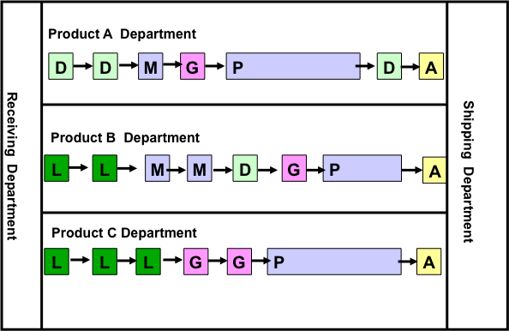
Product Layout
Source: John S. Usher class notes

Slide 9
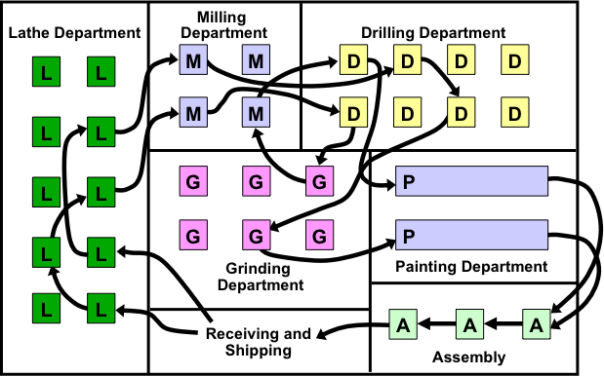
Process layout

Slide 10
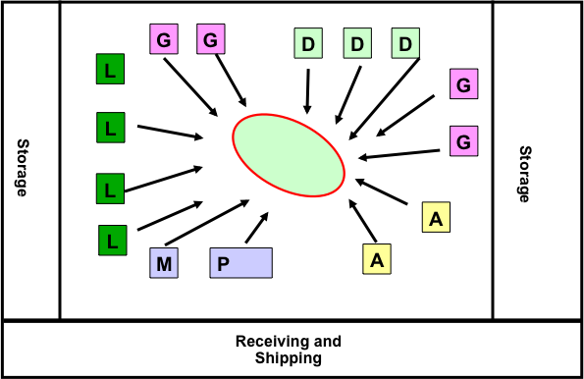
Project (Fixed-Position) Layout
Source: John S. Usher class notes

Slide 11
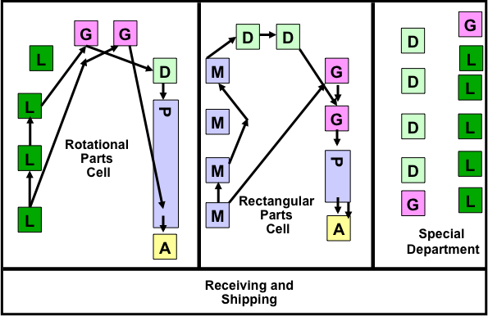
Group technology layout

Slide 12
A Manufacturing Cell
HM
VM
Paths of three workers moving within cell
Material movement
Worker 3
VM
L
Direction of part movement within cell
Key:
S = Saw
L = Lathe
HM = Horizontal milling machine
VM = Vertical milling machine
G = Grinder
Worker 2
G
L
Final inspection
S
Finished part
Worker 1
In
Out
Source: John S. Usher class notes

Slide 13
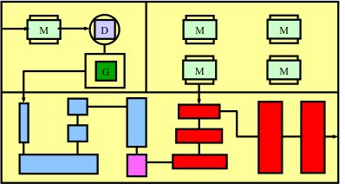
Hybrid layout

Slide 14
General Characteristics
Characteristic | Product | Process | Product Family | Project
Throughput Time | Low | High | Low | Medium
Work in process | Low | High | Low | Medium
Skill Level | Choice | High | Med-High | Mixed
Product Flexibility | Low | High | Med-High | High
Demand Flexibility | Medium | High | Medium | Medium
Mach Utilization | High | Med-Low | Medium-High | Medium
Worker Utilization | High | High | High | Medium
Reliability | Can be low | High | High | Medium
Unit production cost | Low | High | Low | High

Slide 15
Exercise – What Type of Layout?
Ford Louisville Assembly Plant ___________
Meijers ___________
Suburban Hospital ___________
Louisville International Airport ___________
KFC Restaurant ___________
DMV ___________
Boeing Aircraft ___________

Slide 16
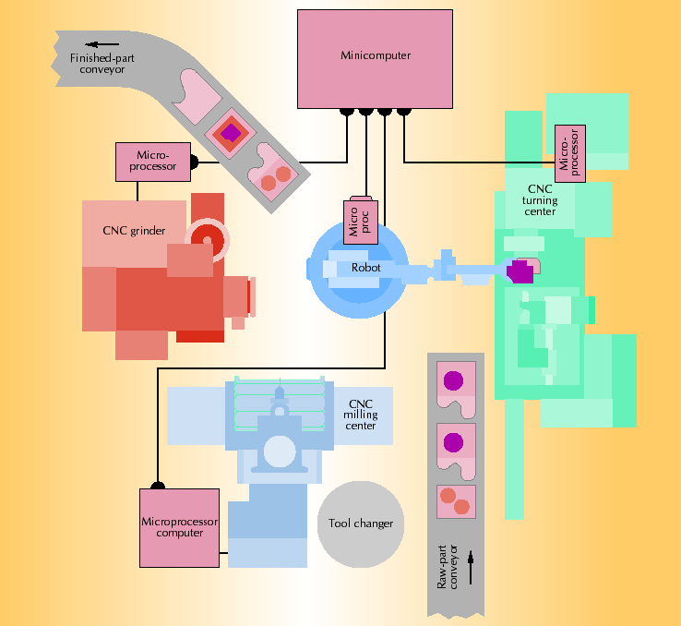
Automated Manufacturing Cell
Source: John S. Usher class notes

Slide 17
Flexible Manufacturing Systems
Automated machining operations, tool changers
Automated material handling, computer control
Designed around size of parts processed & average processing time for parts
Can process wide variety of items quickly
Very few large systems exist
Progressive layout – all parts same route
Closed loop – larger variety, alternative routes
Ladder layout – two machines work on same part
Open field layout – most complex

Slide 18
Flow process chart

Slide 19
Flow diagram

Slide 20
Qualitative flow data
Relationship chart
A absolutely necessary
E especially important
I important
O ordinary
U unimportant
X undesirable
Percentages of A. E, I, O, U and X ratings
A 2-5%
E 3-10%
I 5-15%
O 10-25%
U 25-60%
X depends

Slide 21
Qualitative flow data
Color coding relationships
A Red
E Orange or Yellow
I Green
O Blue
U Uncolored
X Brown

Slide 22
Sample relationship chart
Code | Reason
1 | Bulky material
2 | Ease of supervision
3 | Safety

Slide 23
Quantitative flow data
From-to frequency of trips matrix

Slide 24
Quantitative flow data
Frequency of trips between departments matrix

Slide 25
Distance Measures
Euclidean
Squared Euclidean
Rectilinear
Tchebychev
Aisle distance
Adjacency
Shortest Path

Slide 26
Euclidean, Squared Euclidean, Rectilinear and Tchebychev

Slide 27
Aisle Distance, Adjacency and Shortest Path

Slide 28
Layout evaluation criteria
c_{ij} cost of moving a unit load of material unit distance between departments i and j
f_{ij} number of loads or trips required between departments i and j
d_{ij} distance between departments i and j

Slide 29
Formula for c_{ij}
r number of MHD types
m number of machines (not machine types)
f_{ijk} number of trips required to transport material from machine i to j via MHD k
d_{ij} distance from machine i to j, for a given layout (in feet)
TL_{k} average percentage of time MHD k travels loaded
LULT_{k} average loading and unloading time per move with MHD k (in minutes)
S_{k} average speed of MHD k (feet per minute)

Slide 30
Formula for c_{ij}
Y_{ijk} 1 if MHD k is used to transport material from machine i to machine j; 0 otherwise
N_{k} number of units of MHD k
C_{k} investment/leasing cost for MHD k per year
OP_{k} labor plus non-labor (fuel, power, maintenance) cost to operate MHD k per minute
T_{ijk} time to transport material from machine i to j via MHD k per trip (in minutes)
MHC_{ijk} total material-handling cost to transport material from machine i to j via MHD k
MHR_{ijk} material-handling cost per unit distance per trip to transport material from machine i to j via MHD k

Slide 31
Formula for c_{ij}

Slide 32
Tools for presenting layout design
Drawings
Templates
Three-dimensional physical models
CAD models

Slide 33
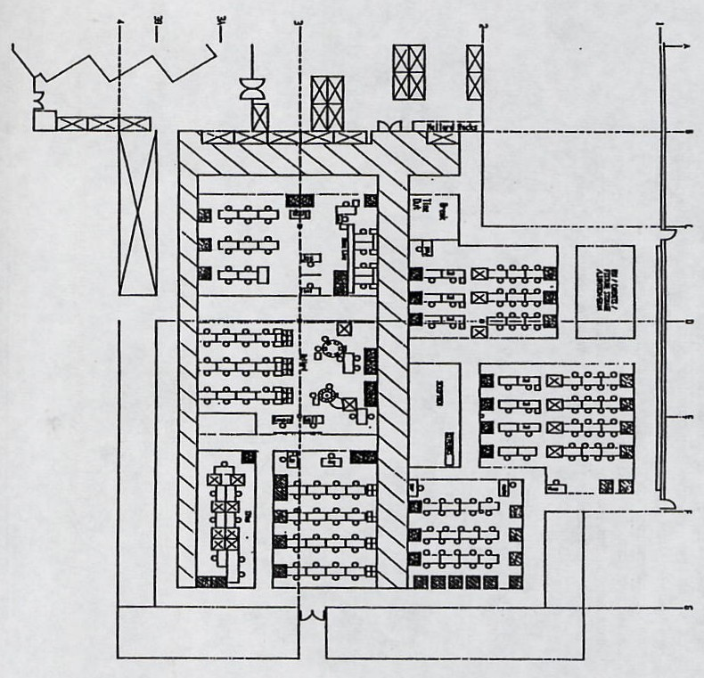
Drawings

Slide 34
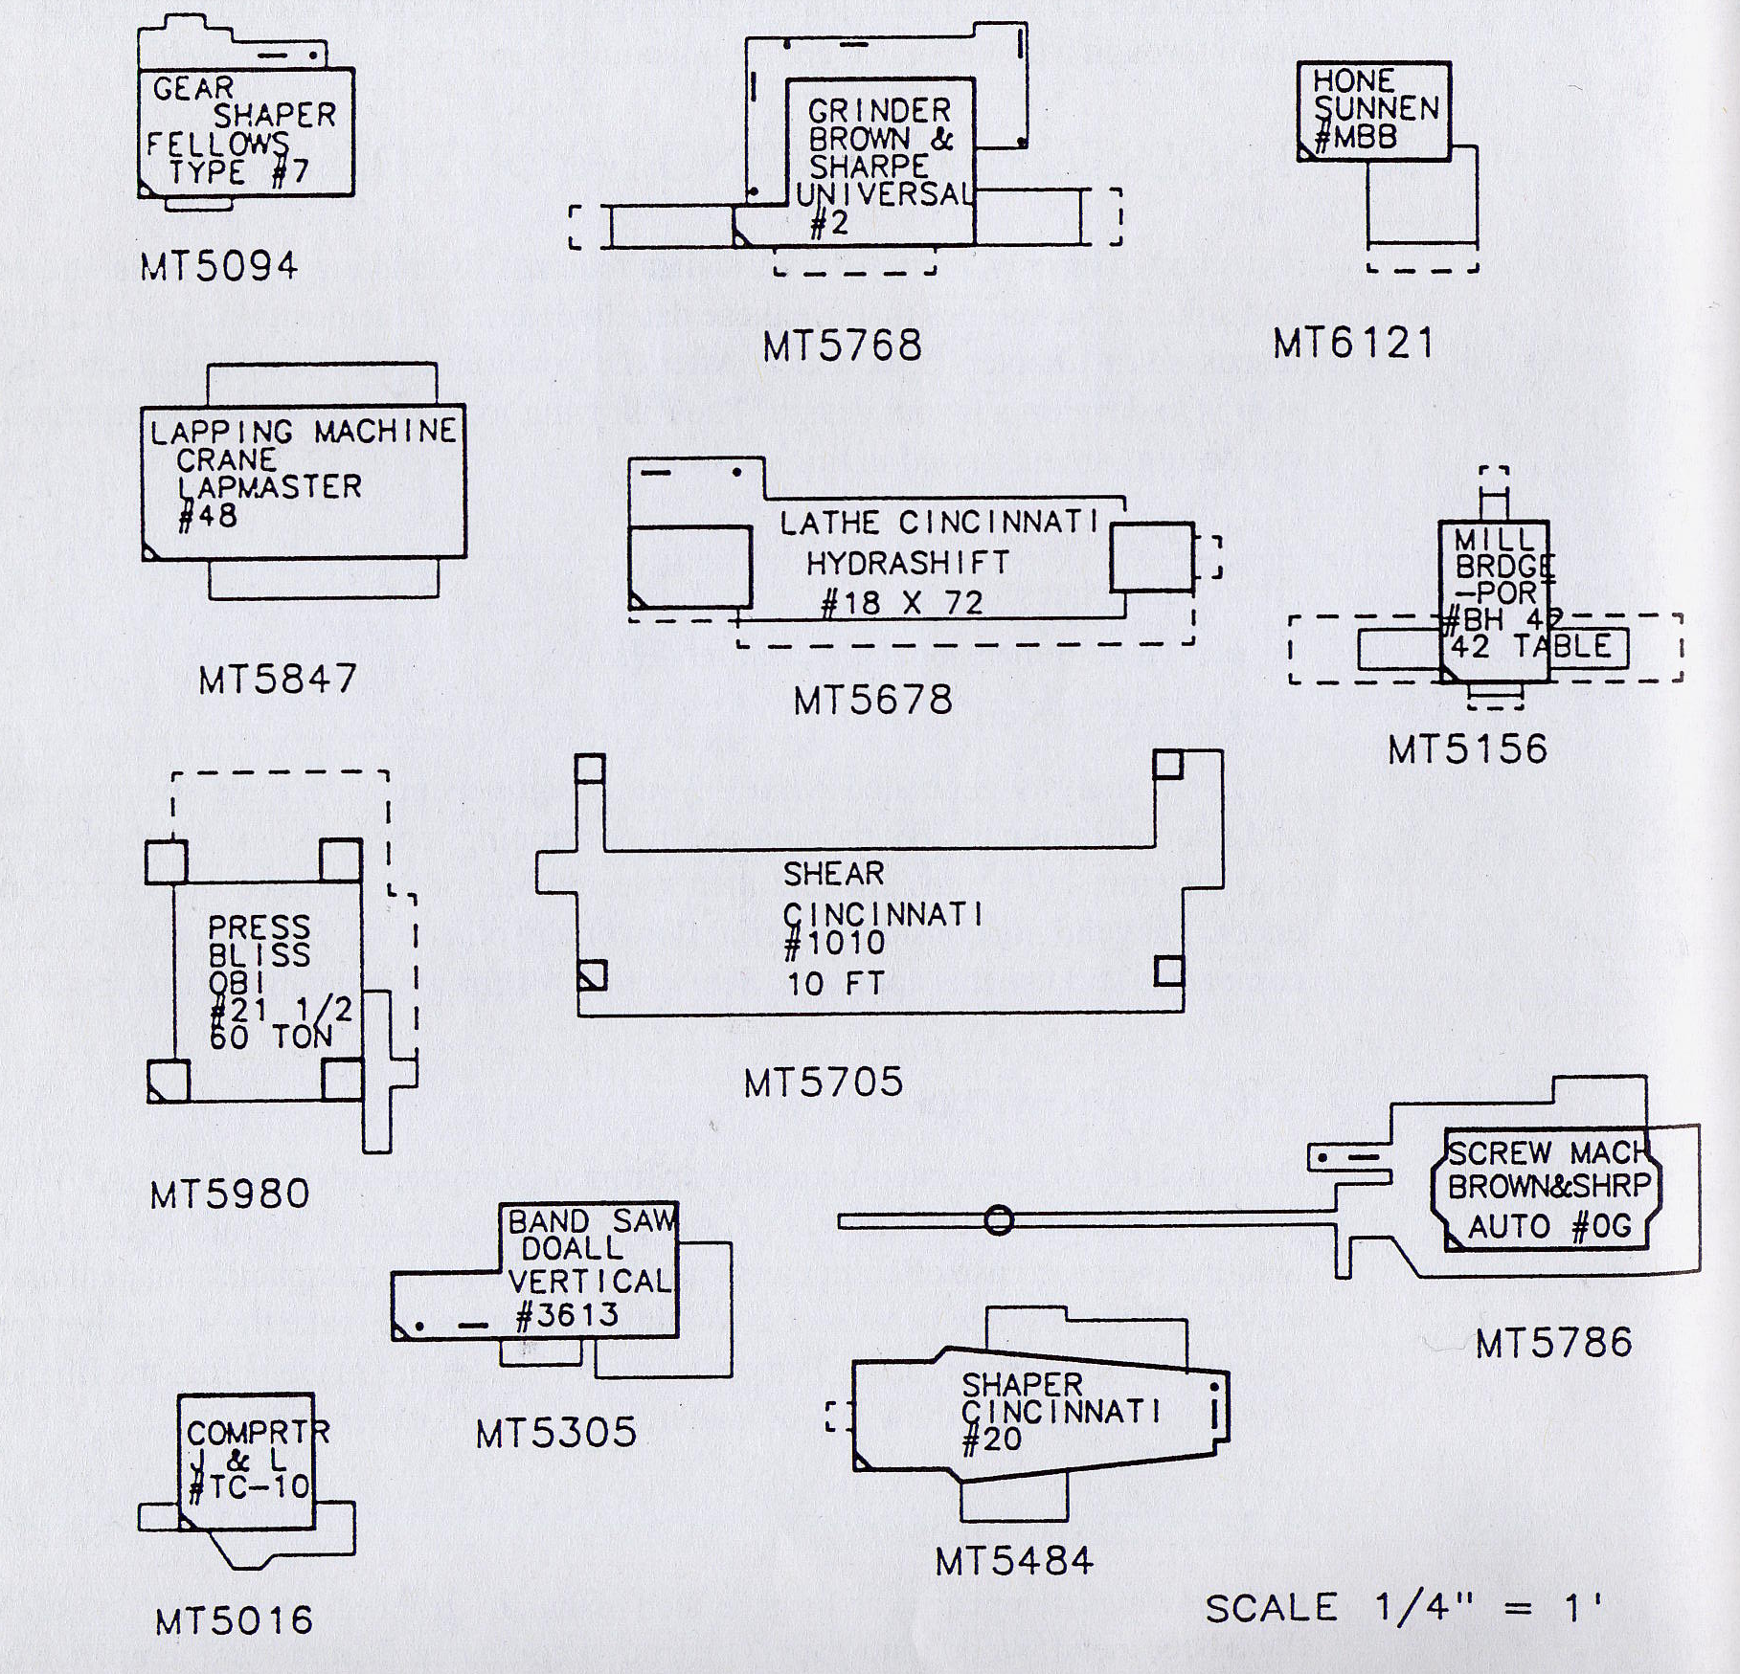
Templates

